Slide 1
DSC 640 – Week 7 & 8 Michael Ersevim

Slide 2
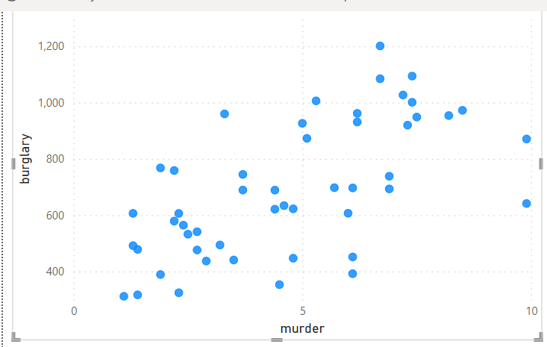
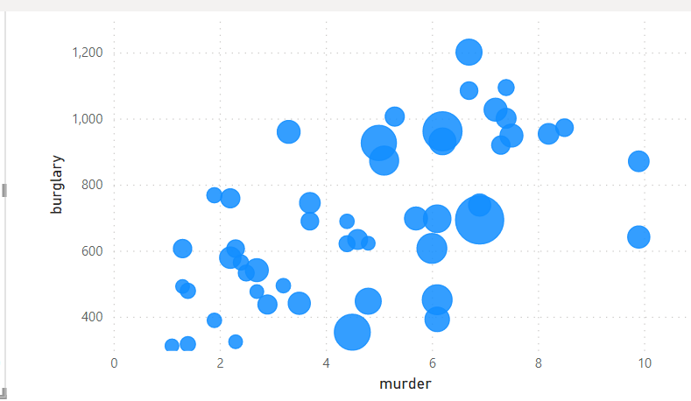
Power BI: Scatter graph and bubble graph

Slide 3
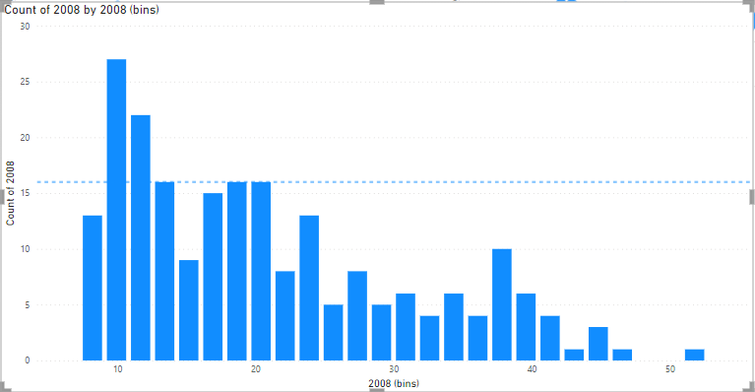
Power BI: Density graph - Bar Graph proxy I know this isn’t a PDF however, I couldn’t figure it out in Power BI so a 25 bin histogram is a proxy to the shape of the PDF or PMF graph.

Slide 4
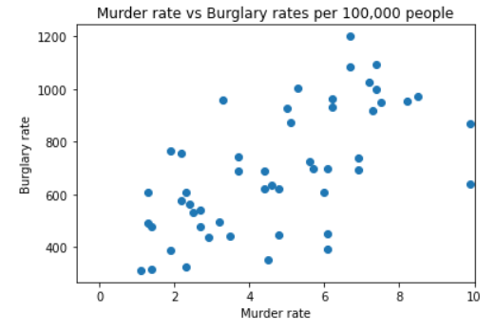
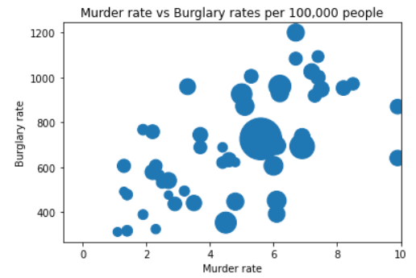
Python: Scatter and Bubble graphs

Slide 5
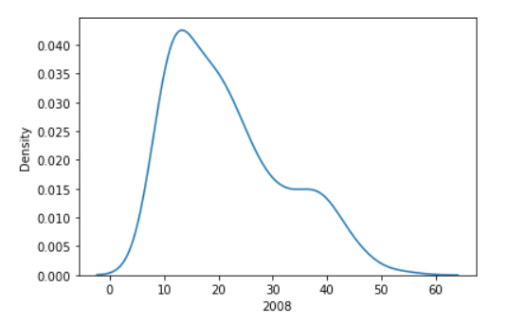
Python: PDF graph of birth rates from 2008: Countries around the world

Slide 6
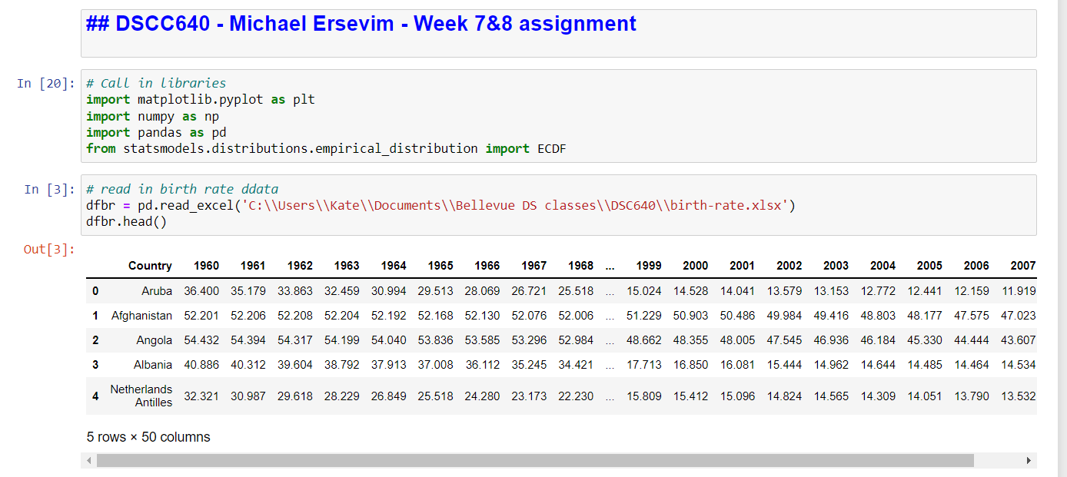
Python: CODE for generating graphs

Slide 7
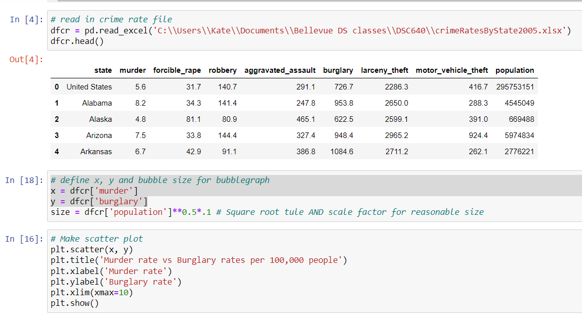
Python: CODE for generating graphs

Slide 8
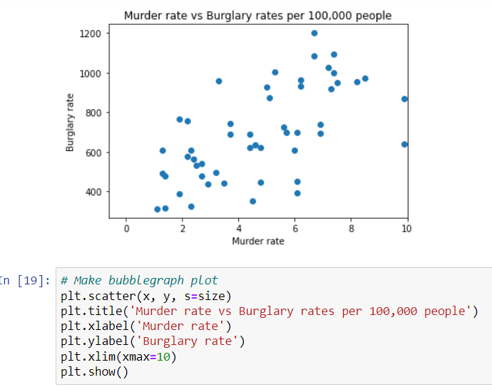
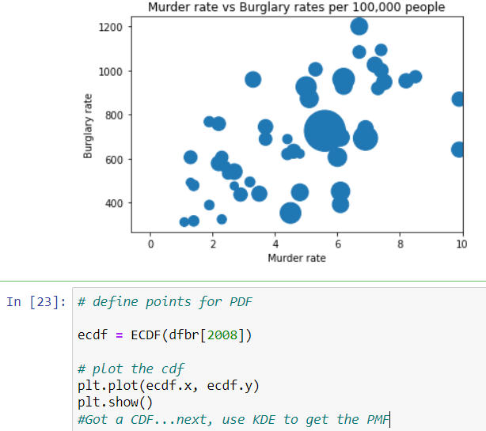
Python: CODE for generating graphs

Slide 9
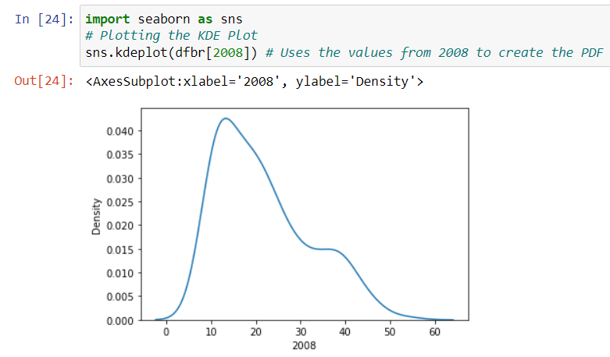
Python: CODE for generating graphs

Slide 10
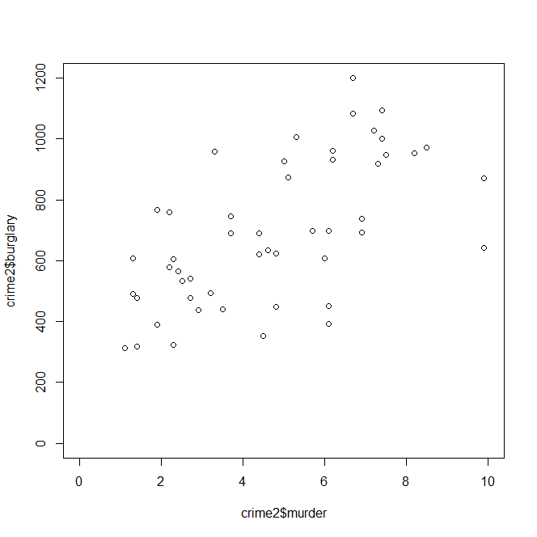
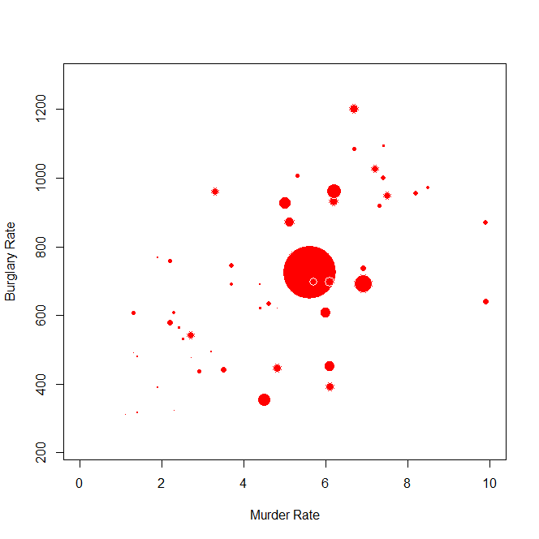
R-graphs
Bubble graph of murder vs burglary rate. Area of bubble should be proportional to population of state, but sqrt of radius function seems not to be working...
Scattergraph of the murder rate plotted against burglary rate to check for correlation (both per 100,000 people)

Slide 11
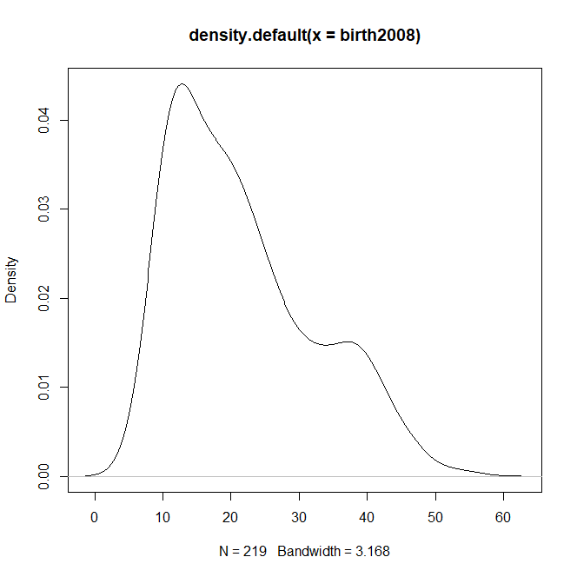
R: Probability Density graph of birth rates (per 1,000 people) across countries from around the world

Slide 12
R: Code for prior graphs Based upon code supplied with ‘Visualize This (N. Yau)’, with a few additions as directed by the text in the book
setwd("C:/Users/Kate/Documents/Bellevue DS classes/DSC640")
# Load the data
crime <- read.csv('crimeRatesByState2005.csv', sep=",", header=TRUE)
# Remove US total and DC
crime2 <- crime[crime$state != "District of Columbia",]
crime2 <- crime2[crime2$state != "United States",]
# Scatterplot for murder and burglary
plot(crime$murder, crime$burglary)
plot(crime2$murder, crime2$burglary)
plot(crime2$murder, crime2$burglary, xlim=c(0,10), ylim=c(0, 1200))
# make bubble chart
radius <- sqrt( crime$population/ pi )
symbols(crime$murder, crime$burglary, circles=radius, inches=0.35,
fg='white', bg='red', xlab='Murder Rate', ylab='Burglary Rate', xlim = c(0,10))
# Scatterplot matrix
plot(crime2[,2:9])

